Slide 1

E.VOTING SYSTEM
ANITA JUDITH NAMAGANDA
AWOR JOY FLORENCE
RWOTHOMIO CALVIN DIEGO
NAMATOVU LIZ TREASURE
OMOYA CHARLES KIDEGA
RUGOGAMU NOELLA

Slide 2
INTRODUCTION.
An E.voting system that portrays the different principles of Object-Oriented Programming that is to say abstraction, encapsulation, inheritance and polymorphism.
We zeroed down to Mukono as the voting location where one has to be a resident of the area and 18 years and above inorder to vote.
The election is a mayoral election with two candidates who must be between the ages of 25 to 70 years and a resident of Mukono inorder to qualify for candidacy.
When someone votes for a candidate, the system automatically adds to his votes and displays the winner at the end.

Slide 3
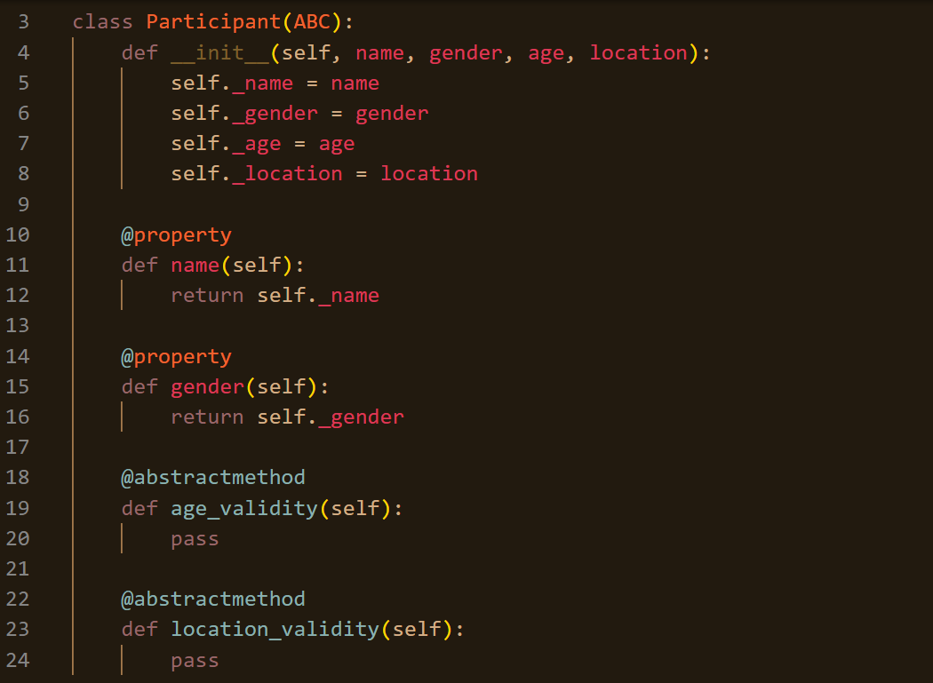
ABSTRACTION.
We created an abstract class participants with abstract methods age_validity and location_validity.
These methods were then implemented in the subclasses.

Slide 4
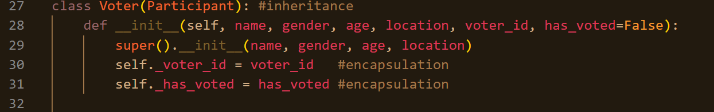
INHERITANCE.
We created subclasses voter and candidate that inherit from the abstract class participant.

Slide 5
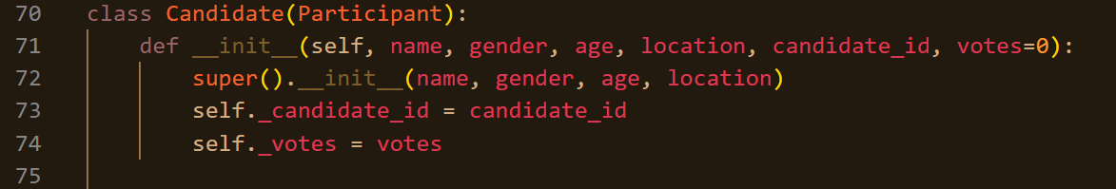

ENCAPSULATION.
We used underscores before each attribute to encapsulate it and used getters to access these attributes.

Slide 6
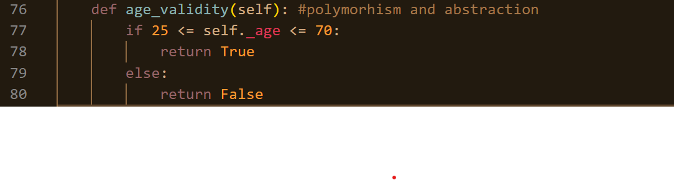
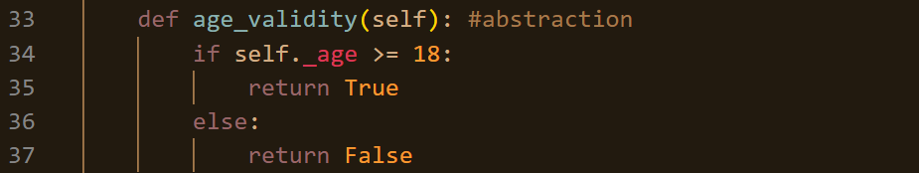
POLYMORPHISM.
The age_validity method was implemented differently in both the voter and candidate classes.

